Slide 1


PLAYER AID
Conduct Counter-Attack (cost = 1 action)
See Counter Attacks
unmodified roll of 1 is always unsuccessful
unmodified roll of 6 is always successful
PLAYER ACTIONS
COUNTER-ATTACKS
Defense Strength is Terrain Val + Army Value + Defense Modifiers
Attack Strength is Attack Modifiers
If Roll + Attack Strength > Defense Strength – advance ALL units
Cost 1 supply point if Pz Div/Kampgruppen involved (not 101st)
Victory is +1 to Hitler Approval
Defeat – 1 elim: take loss from Pz unit, Nebel, Fallsch or Fortified Village
unmodified roll of 1 is always unsuccessful / 6 successful
Cannot counter-attack beaches after turn 2 or Fortresses ever
Deploy Reinforcements
Panzer Divisions make Transport Check (Success is <= Transport Level)
Successful – place in Strategic Reserve Box
Unsuccessful – Leave in In Transit Box
Units in In Transit Box make 1 Transport Check per turn (free); successful roll: move to Strategic Reserve Box
To deploy from Strategic Reserve Box to map - must pass Hitler Check (cost = 1 action
Kampfgruppen/Nebel/Flak/Fschmjgr move directly to map or to Strategic Reserve Box (no cost)
Deploy Kampfgruppen/Nebel/Flak/Fschmjgr from the Strategic Reserve Box to map (no cost)
RESOURCE CHECKS / AUGMENTATION ROLLS
To augment (increase) resource pay 1 action
If roll > Base Value on counter increase by 1
For resource checks must roll <= current value
+1 DRM on Transport and Supply if weather is overcast
No Resource Check on Supply points, these are just spent on attacks
Redeploy Panzer Unit to Strategic Reserve Box (cost = 1 action)
Move Pz Unit to SR Box: Must pass Transport Check
May not move/redeploy in to/out of Siege
SIEGES
If Defense Value is >= 6 more than Attack Value in Fortress – Declare Siege. 1d6 Siege Table when army listed to attack
Cannot move/deploy units into or out of besieged space
Place Siege marker on space
4. Refit Reduced Panzer Unit (cost = 1 action)
Must be in Strategic Reserve Box
Cannot refit Kampfgruppen or rebuild eliminated units
Reduced Panzer Units are flipped to Full Strength (+1 to +2)
ALLIED ARMY ADVANCE
Defense Value = Terrain Value + Defense Modifiers
Attack Value = 0 + Attack Modifiers
If die roll + Attack Value > Defense Value – advance army
If attack <= defense, not in fortress, 1 loss (no advance)
If attack > than defense, defender takes 1 loss (advance) and if pz unit present
5. Resource Augmentation Roll(cost = 1 action per track)
Roll > Base Value to increase resource level
All DRMs on cards are for Resource Checks NOT Augmentation Rolls except weather +1 DRM
US 3rd ARMY BREAKDOWN
6. Build Fortified Villages (cost = 3 actions per level)
Place “Fortified Villages” +1 or upgrade to +2
Defense Value +1 or +2 until captured
Siege Rules do not apply
Place on any German held space except Falaise Gap
Roll 2d6 >= 12 on US 3rd Army Activation Table to activate US 3rd Army
VIII Corps moves to St Malo (then into Britanny)
XV Corps moves to Rennes
Recombine if VIII Corps “catches up”
SUPPLIES
7. Put Action(s) to Strat Res Box (cost = 1 action)
Max. 2 Actions in Reserve Box
Can be used in future turns
Attacks cost 1 Supply Point if Panzer Units present (divisions, Kampfgruppen count, 101st Pz Bn does not)
Redeploy a panzer unit from map to Strategic Reserve box
Deploy Panzer Unit from In Transit or Strategic Reserve to map
Avoid having to carry out “Hitler Interventions” as defined by several Event Cards
“Hitler Intervention” cards: the player must fail the check for the intervention to go ahead
-1 for loss of S Caen, -2 Brest, Lorient
-1 for defeat on defense when Panzer units present
8. Move Unit One Space (cost = 1 action)
Any unit can move forwards or backwards 1 space
HITLER APPROVAL
D-DAY LANDINGS
Cards #1 and #2 always first two cards
Roll 1d6: Brit/Can armies succeed if roll > 1
US 1st Army succeed if roll > 2
If success put army into its beach box
If fail, leave in start box
Always succeed on turn 2
VICTORY/DEFEAT
STACKING
Any Allied Army reaches space 0 (Falaise Gap) -> LOSE
Hitler Approval reaches -2 -> LOSE
No cards left and Falaise Gap German controlled -> WIN
4 panzer units (incl. Kampfgruppen), 3 Nebelwerfer, 2 Fallschirmjäger, 3 88mm FlaK units per space. purposes; 101st does not count

Slide 2
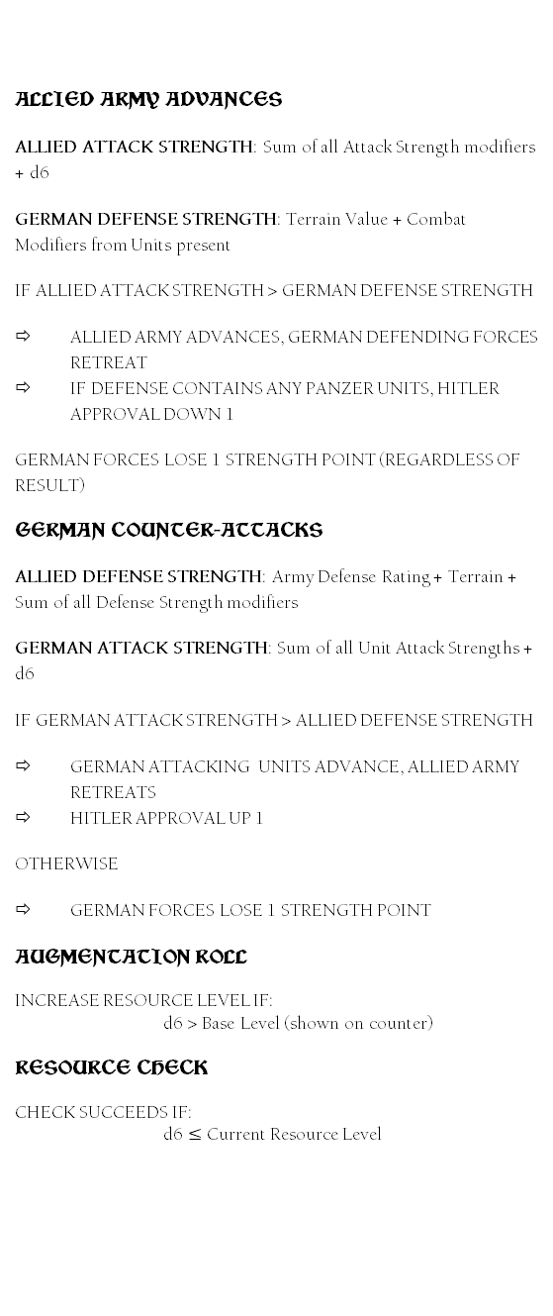
ALLIED ARMY ADVANCES
ALLIED ATTACK STRENGTH: Sum of all Attack Strength modifiers + d6
GERMAN DEFENSE STRENGTH: Terrain Value + Combat Modifiers from Units present
IF ALLIED ATTACK STRENGTH > GERMAN DEFENSE STRENGTH
ALLIED ARMY ADVANCES, GERMAN DEFENDING FORCES RETREAT
IF DEFENSE CONTAINS ANY PANZER UNITS, HITLER APPROVAL DOWN 1
GERMAN FORCES LOSE 1 STRENGTH POINT (REGARDLESS OF RESULT)
GERMAN COUNTER-ATTACKS
ALLIED DEFENSE STRENGTH: Army Defense Rating + Terrain + Sum of all Defense Strength modifiers
GERMAN ATTACK STRENGTH: Sum of all Unit Attack Strengths + d6
IF GERMAN ATTACK STRENGTH > ALLIED DEFENSE STRENGTH
GERMAN ATTACKING UNITS ADVANCE, ALLIED ARMY RETREATS
HITLER APPROVAL UP 1
OTHERWISE
GERMAN FORCES LOSE 1 STRENGTH POINT
AUGMENTATION ROLL
INCREASE RESOURCE LEVEL IF:
d6 > Base Level (shown on counter)
RESOURCE CHECK
CHECK SUCCEEDS IF:
d6 $≤$ Current Resource Level
PLAYER AID
DETAILED SEQUENCE OF PLAY
Event Phase. Draw Event Card
Weather Phase. Roll on weather table; 1 (overcast) gives +1 DRM to Transport and Supply Augmentation Rolls. Roll on Carpet Bombing if applicable
Resource Phase
1. Add Jabo/Carpet Bombing markers to Allied Armies
2. Add Attack/Defense Strength markers to Allied Armies
3. Add DRMs to Resource Tracks
4. Add Panzer Div reinforcements to In Transit box
5. Add Other reinforcements to map/Strategic Reserve box
Allied Advances Phase
1. Move all active Allied armies as indicated on the Event Card (from left to right on the card).
2. Calculate Attack and Defense Strengths
3. Resolve combat
4. Advance Allied Army/Retreat Defenders if Allied Army won
5. Modify Hitler Approval if necessary
Player Action Phase (cost in parenthesis)
Launch counter-attack (1 per attack)
Redeploy Panzer Divisions to/from the Strategic Reserve box (1)
Refit reduced Panzer Division (1)
Attempt to increase a Resource on its Resource Track (1)
Fortify Villages (3)
Move Unit one space (1)
Put 1 or 2 Actions into Strategic Reserve Box (1 per action)
Housekeeping Phase
Remove all JABO, Carpet Bombing, DRM, Strength, Commander markers

